Slide 1

MVA Project
Indian Bank loan analysis
Group 11
Casanova Lloveras, Adrià
Chimeno Sarabia, Alícia
García Pizarro, Víctor
Giurcoiu, Victor-George
Ji, Zhengyong
Notes:
Ji

Slide 2
INDEX
MOTIVATION AND DATA SOURCE PRESENTATION
EDA - EXPLORATORY DATA ANALYSIS
Data Context
Variables description
DATA PREPROCESSING
RECODIFICATION
IMPUTATION
KNN
MIMI
MICE
PCA - PRINCIPAL COMPONENT ANALYSIS
OUTLIERS DETECTION
MCA - MULTIPLE CORRESPONDENCE ANALYSIS
Notes:
Ji

Slide 3

Data Transformation
PCA
Data Exploration Analysis
Preprocessing:
- Recode
- Imputation
Extract
raw data
MCA
Outlier Detection
Mahalanobis distance
Notes:
Ji

Slide 4

Motivation and Data Source Presentation
IIIT Bangalore, the International Institute of Information Technology Bangalore
Socio-economic indicators from the clients who have applied for a loan
Analyze the capability of the client to return their loan on-time or not
Real world applications in the banking and financial services
Risk analysis for the company to minimize the capital lose
Notes:
Ji

Slide 5
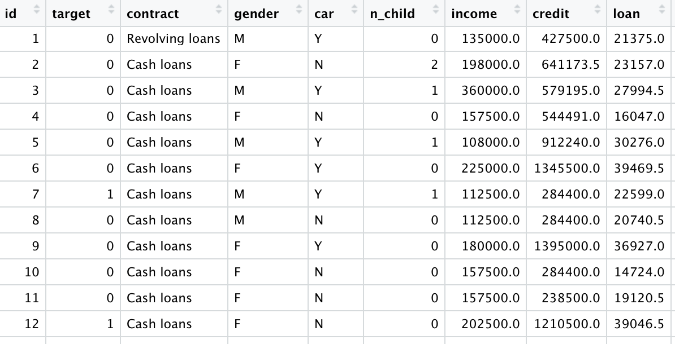
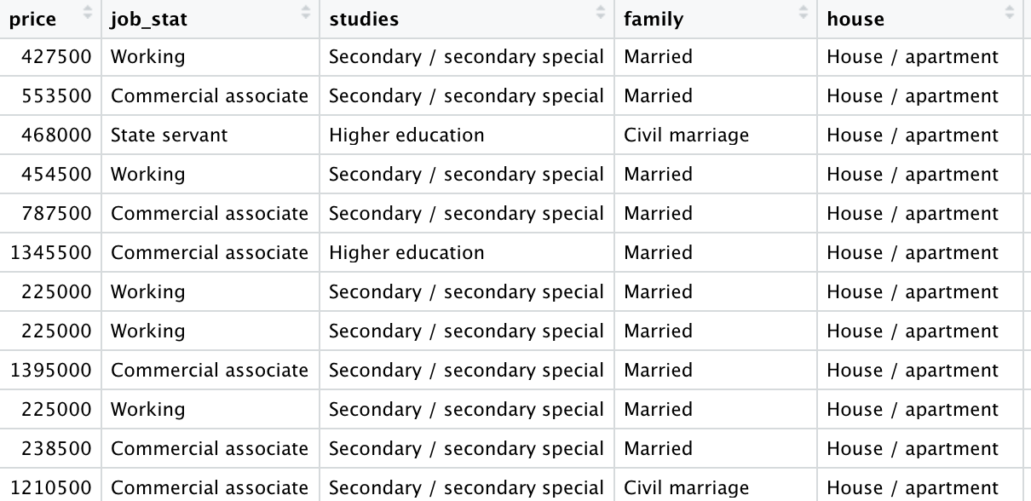
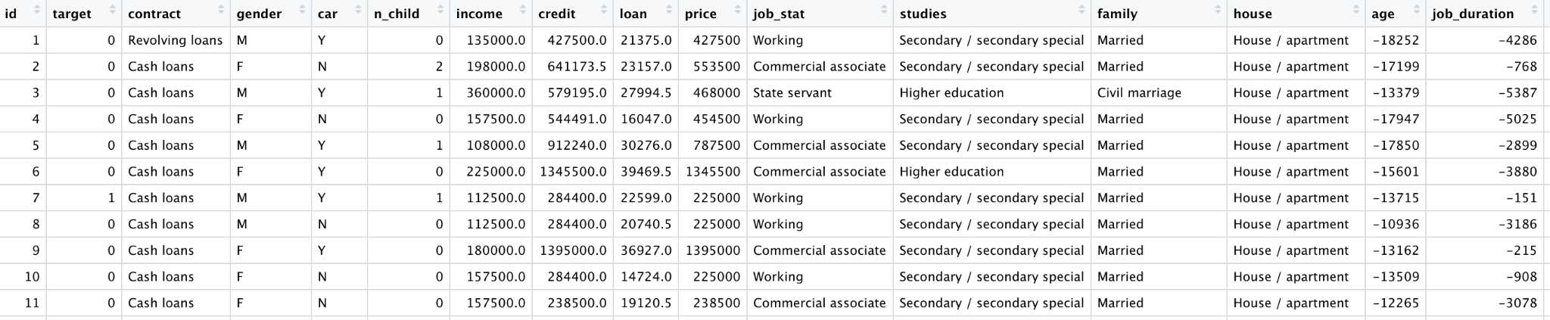
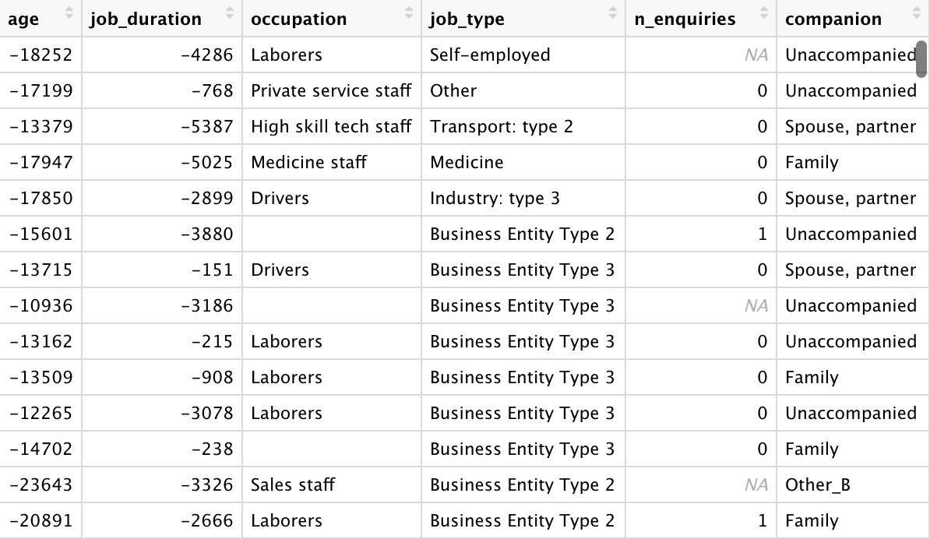
DATA OVERVIEW

Slide 6
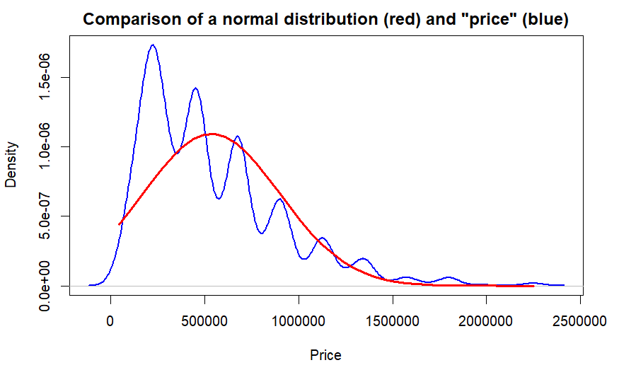
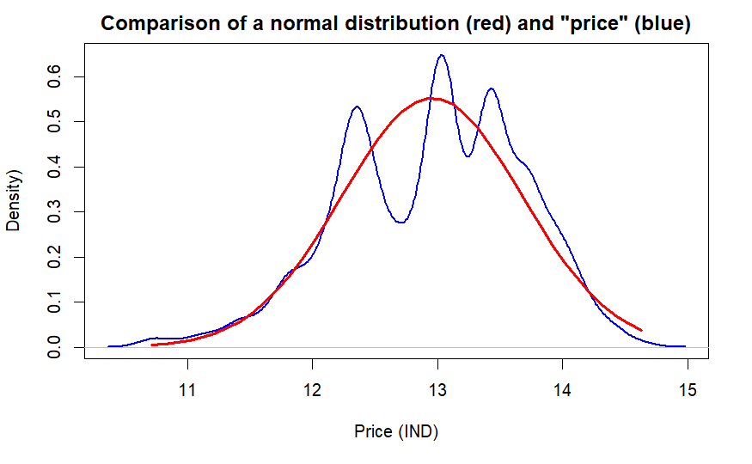
EDA - DATA EXPLORATION. Main conclusions
Distribution of variables is not normal. The sample shows interesting distributions that can be used to extract knowledge (e.g: goods price)
Notes:
Victor G

Slide 7
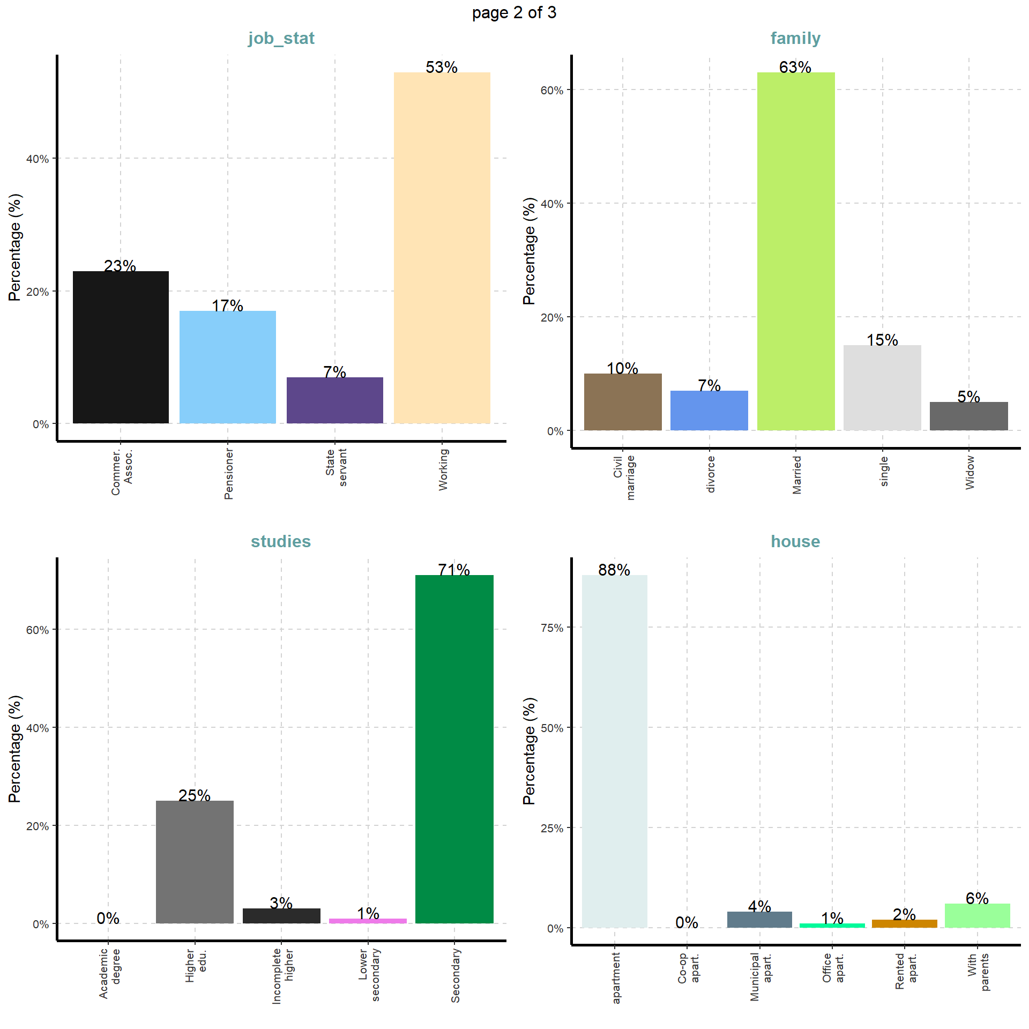
EDA - DATA EXPLORATION. Main conclusions
2) Sample is highly unbalanced, specially in the target variable (91% returned the loan). Interpretation of plots and interpolations to the general population must be done with care.
Notes:
Victor G

Slide 8
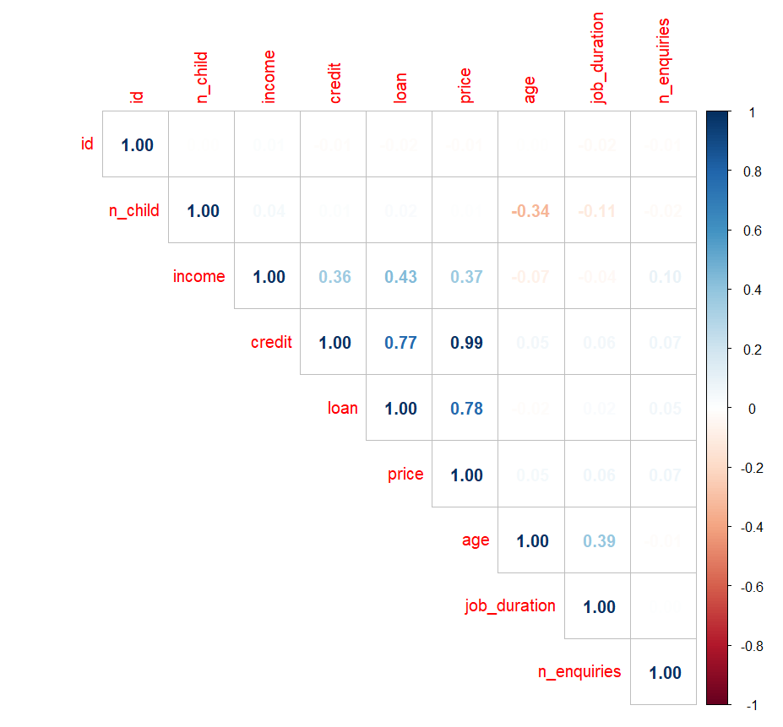
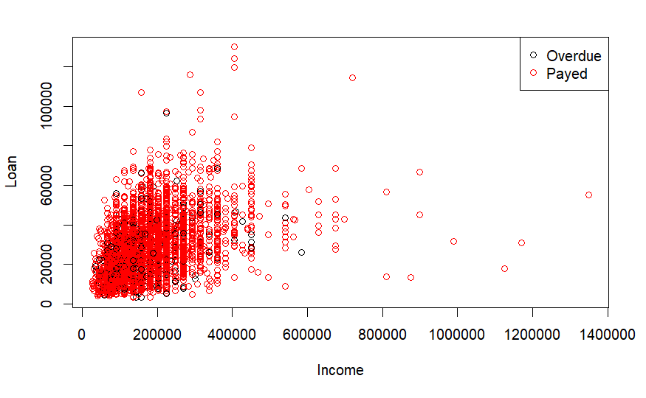
EDA - DATA EXPLORATION. Main conclusions
Income is not directly related to the amount of money that is given for a loan (R^2 = 0.36)
Notes:
Victor G

Slide 9
DATA PREPROCESSING - Recode Variables
used shorter names for variable names
used shorter names for categories
changed 365243 value in job_duration to NA
job_duration, age: transformed from negative days to years
reduced categories to a higher level
Notes:
VG

Slide 10
Approaches for Imputations
Qualitative variables
missing values: occupation (30.68%), job_type (17.18%), companion (0.56%)
new modality: “Variablename_Unknown”
Numerical variables
missing values: job_duration (17.18%), n_enquires (13.78%), price (0.12%)
Little Test (mcar_test) => variables either missing at random or not
assumption: variables missing at random
imputation methods: MIMI, MICE, KNN
Notes:
VG

Slide 11
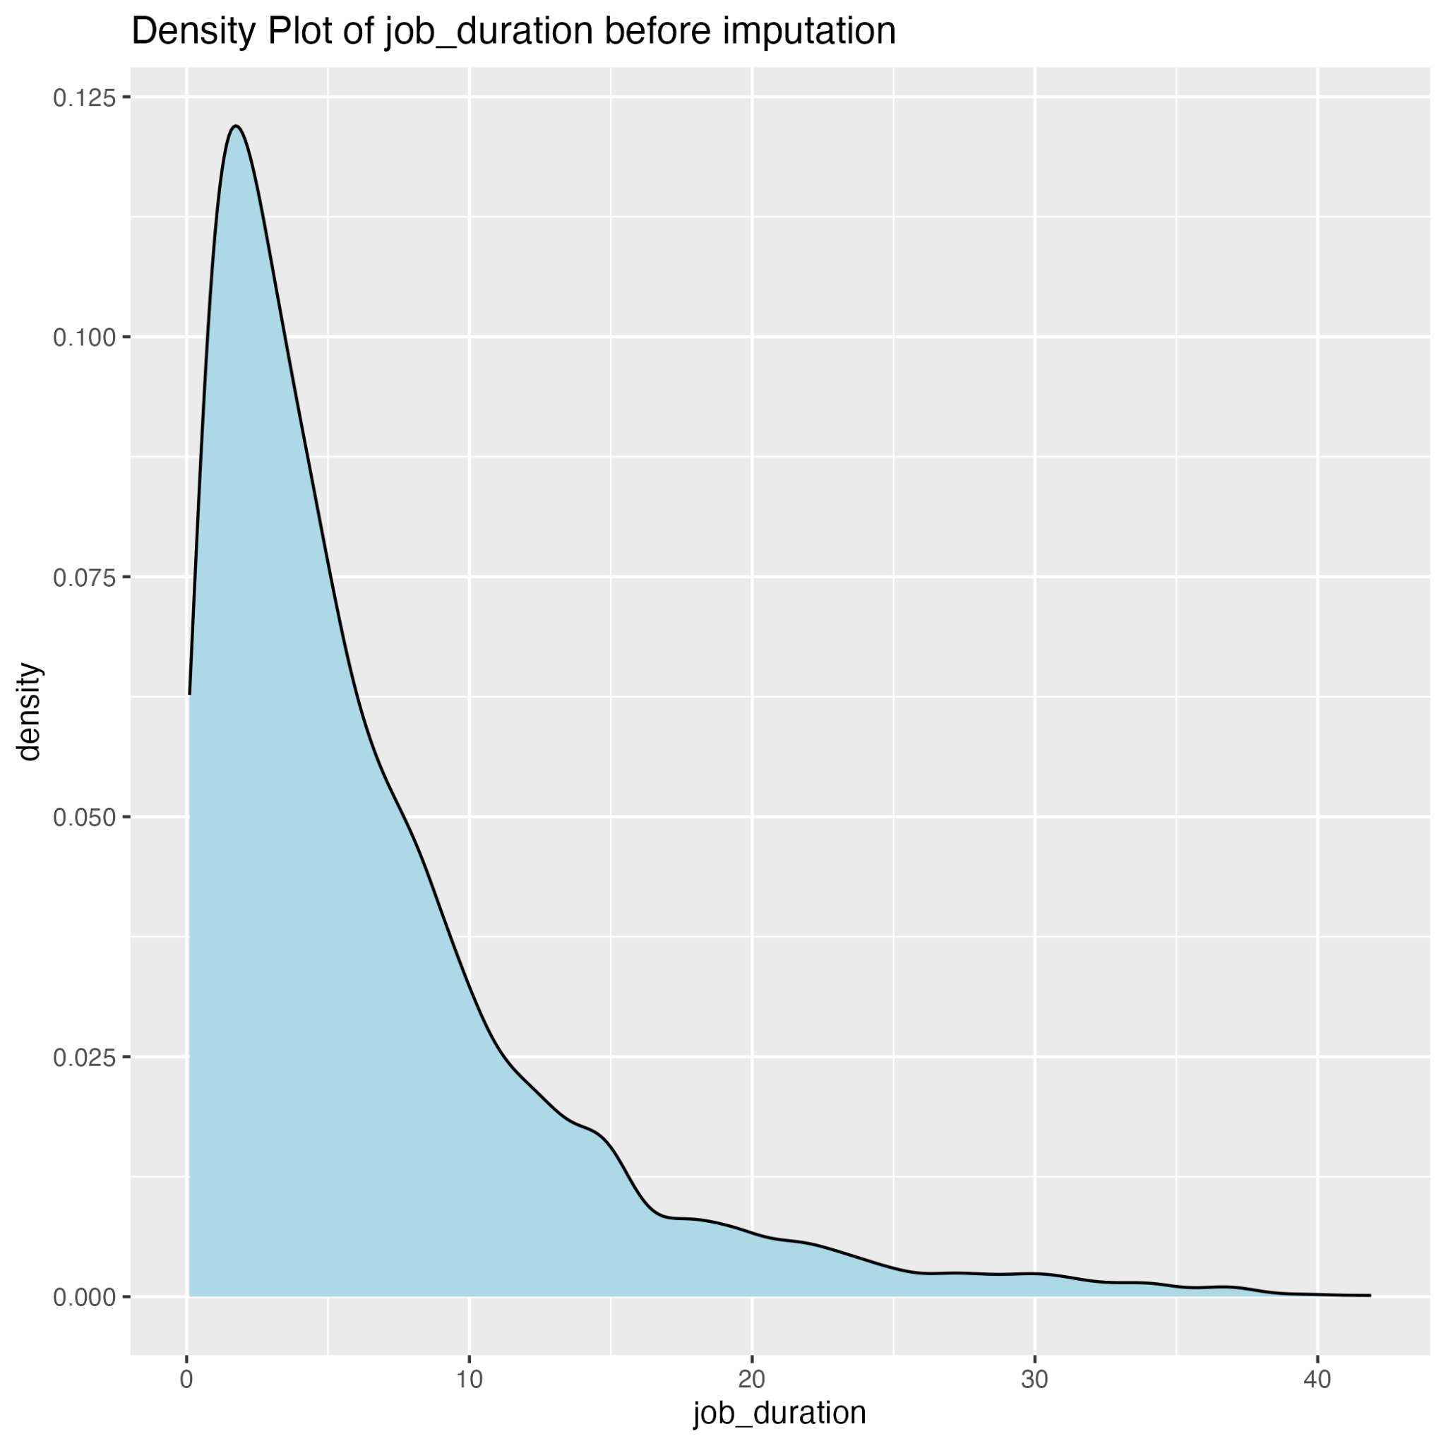
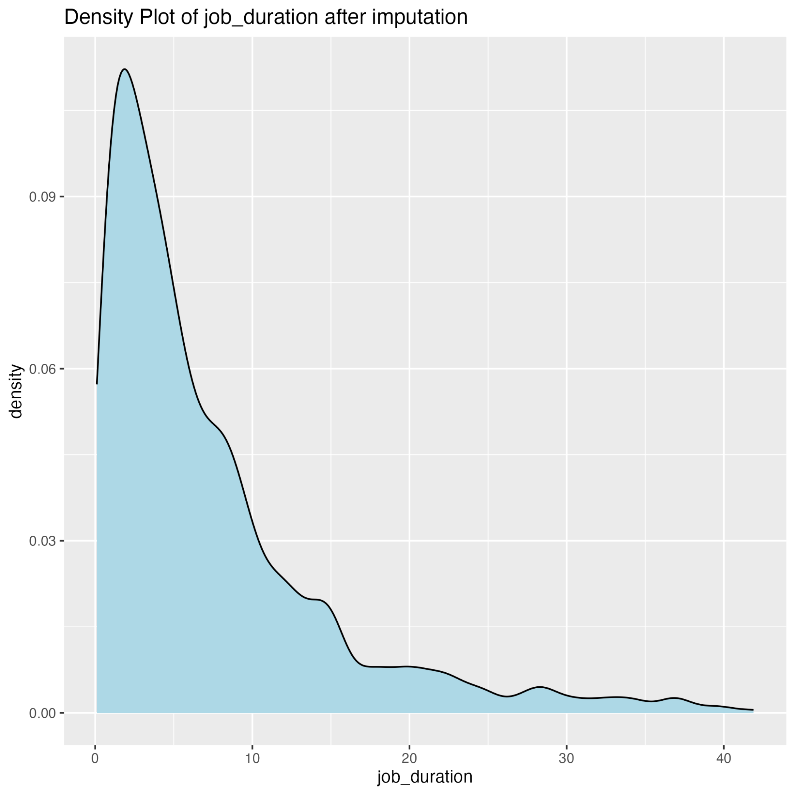
Distribution Analysis Before and After Imputation
Notes:
VG

Slide 12
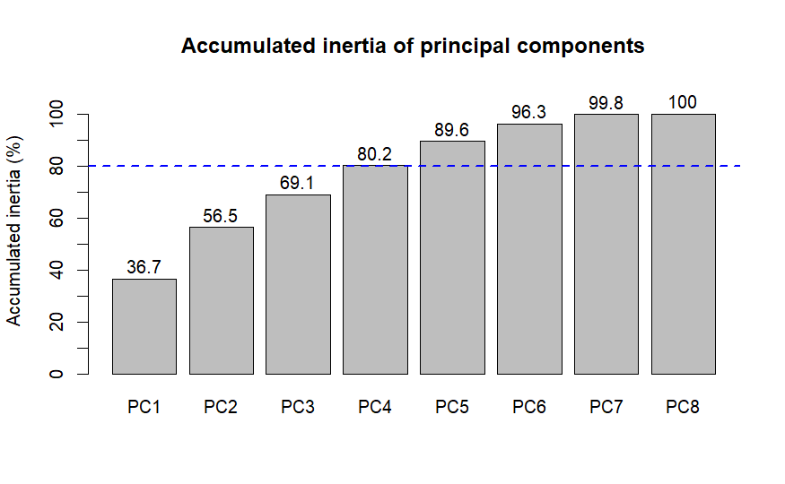
PCA - Principal Component Analysis
Notes:
Adrià

Slide 13
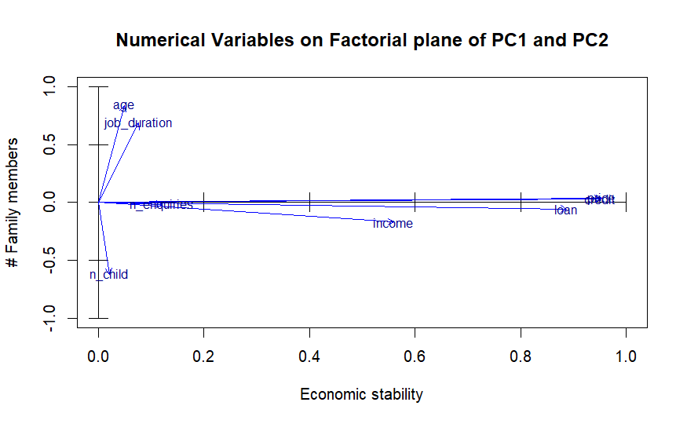
Notes:
Adrià

Slide 14
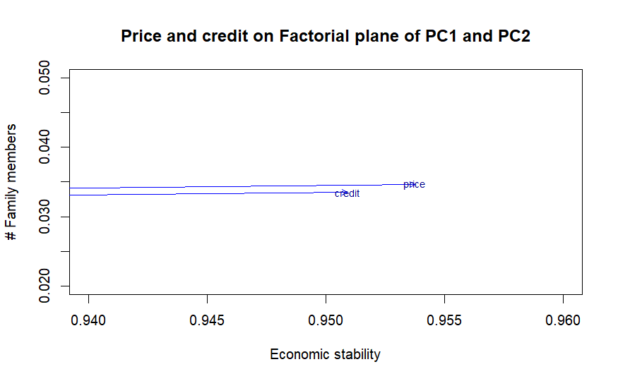
Notes:
Adrià

Slide 15
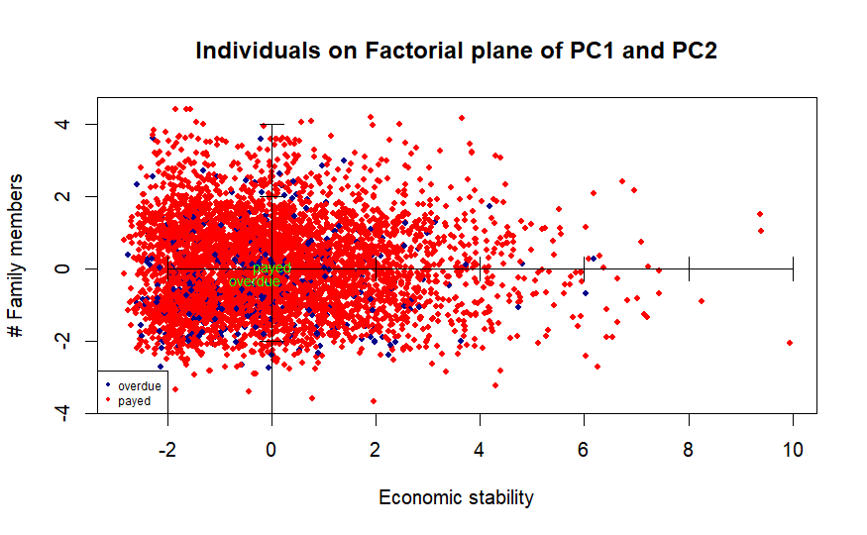
Notes:
Adrià

Slide 16
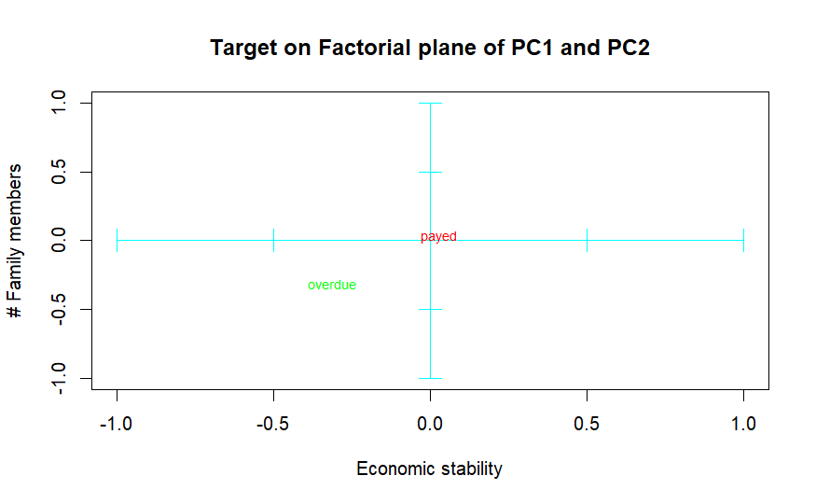
++ family
— wealth
Notes:
Adrià

Slide 17
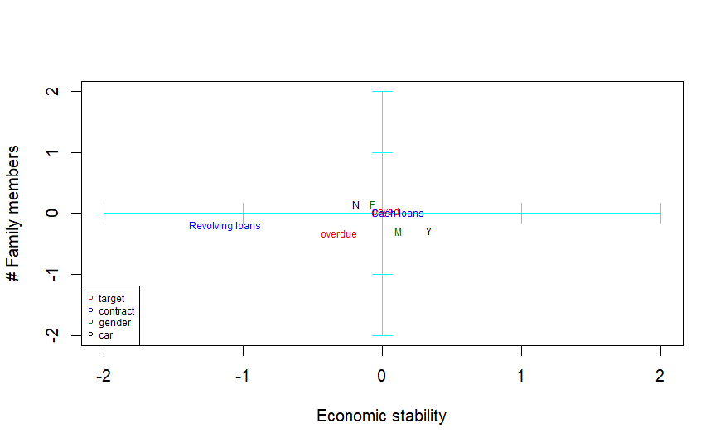
Relevant conclusions
Women usually don’t own a car and men do
Less stable individuals usually ask for revolving loans instead of installment loans
Notes:
Adrià

Slide 18
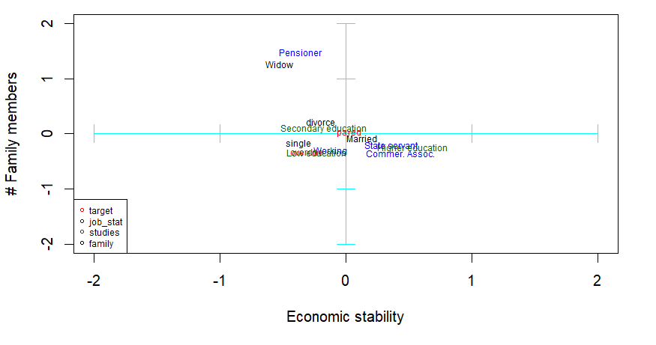
Highly educated individuals tend to work for the state or in commerce
Paid on time => married or divorced and have a secondary education
Payment delayed => single, with a low education and don’t work for the state nor in commerce
Notes:
Adrià

Slide 19
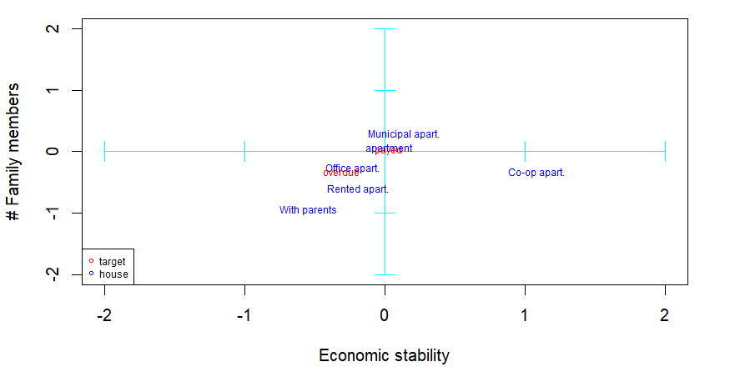
Clients that delay the payment tend to live in office apartments and, to a lesser extent, in rented apartments
Those who do not, usually live in standard or municipal apartments
Notes:
Adrià

Slide 20
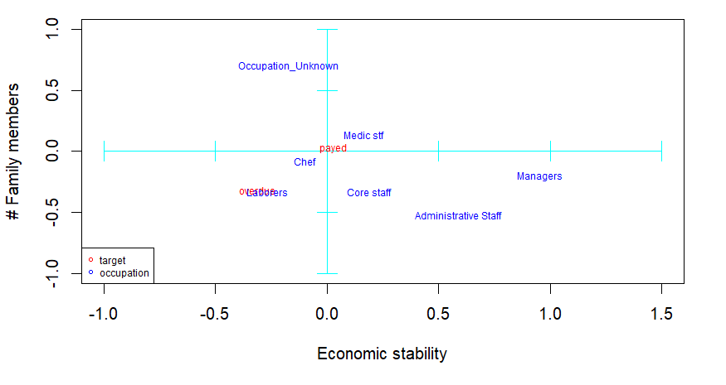
Medic staff and chefs are the clients that pay the loan on time most often
Specially laborers, but also waiters, sales staff and realty agents, normally belong to the overdue modality
Notes:
Adrià

Slide 21
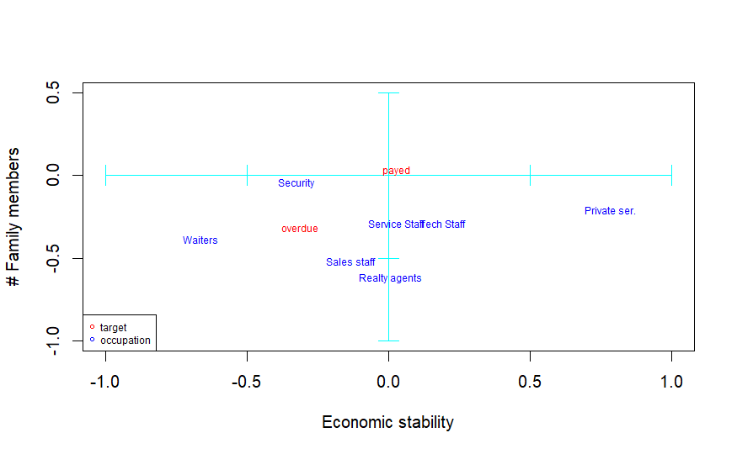
Notes:
Adrià

Slide 22
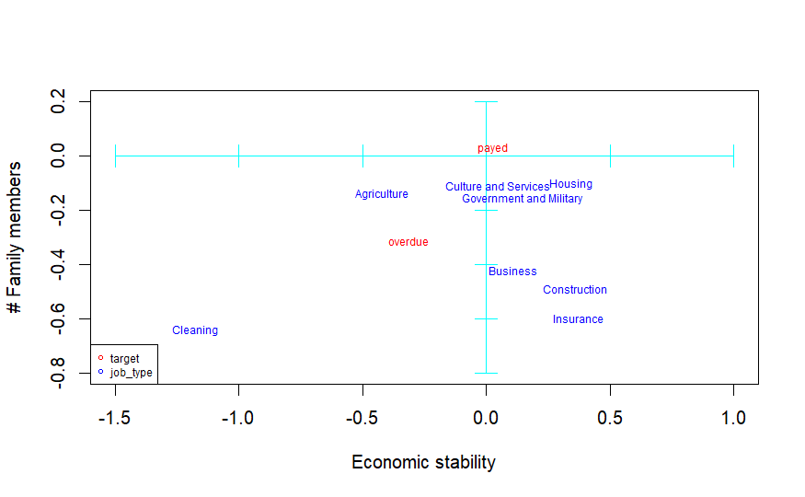
Notes:
Adrià

Slide 23
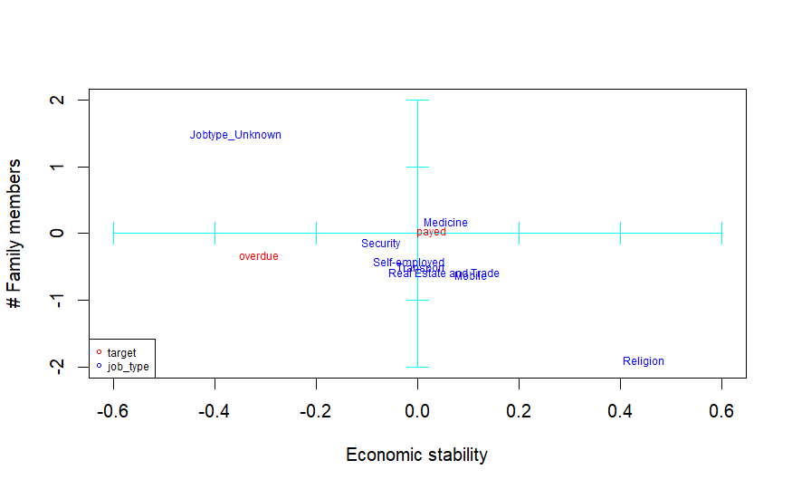
Notes:
Adrià

Slide 24
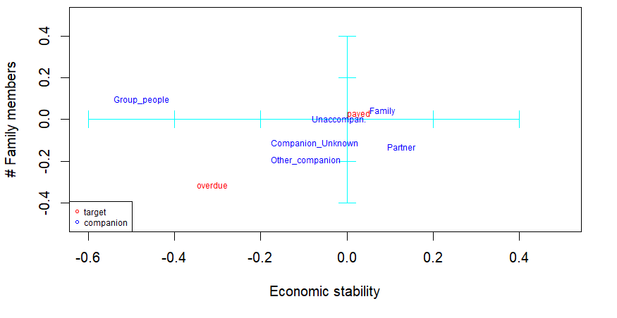
Paid on time => unaccompanied or with their families
Ask for the loan together with a group => economically unstable
Notes:
Adrià

Slide 25
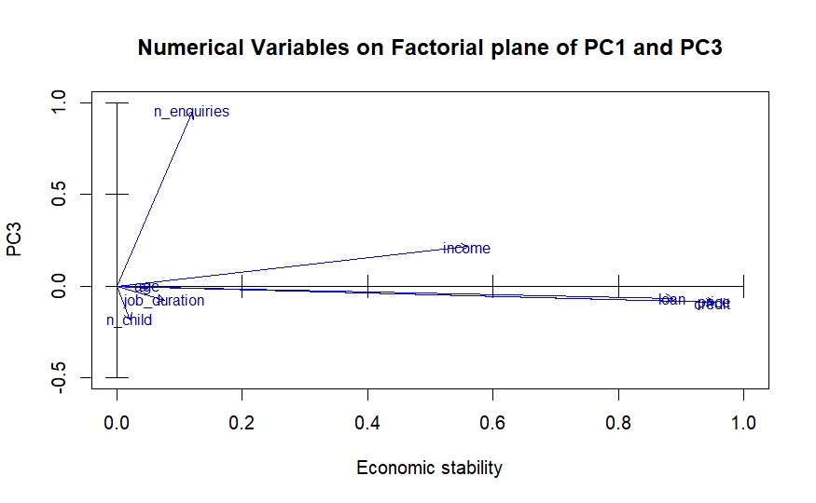
Notes:
Ji

Slide 26
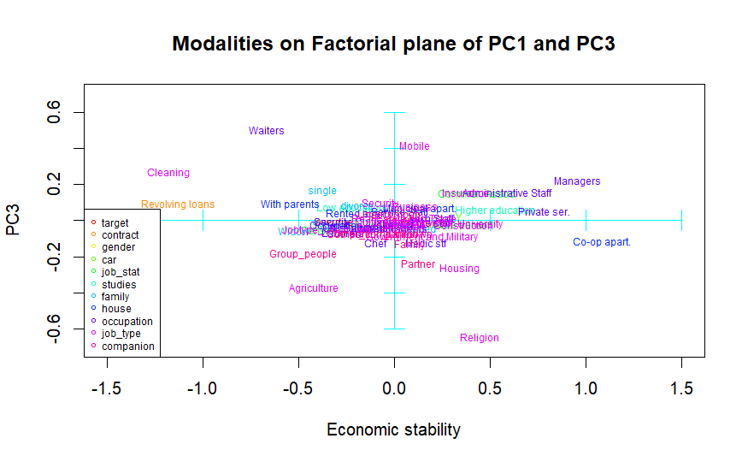
Notes:
Ji

Slide 27
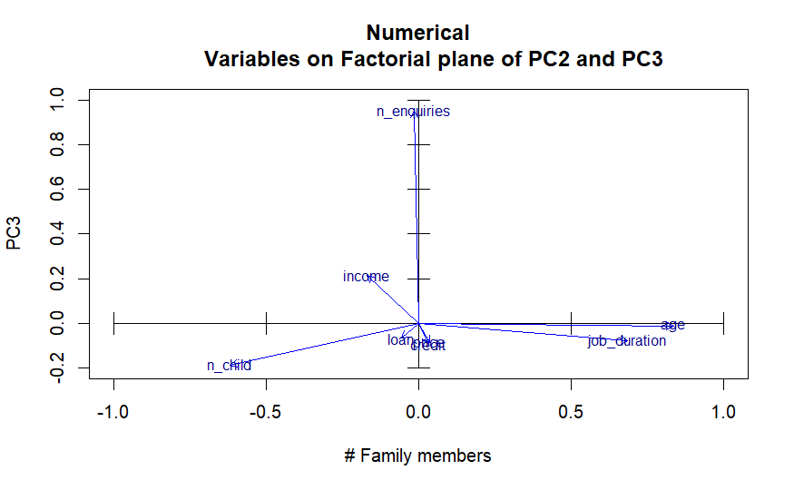
Notes:
Ji

Slide 28
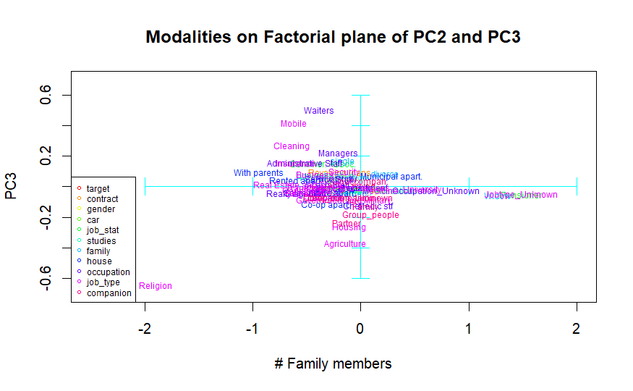
Notes:
Ji

Slide 29
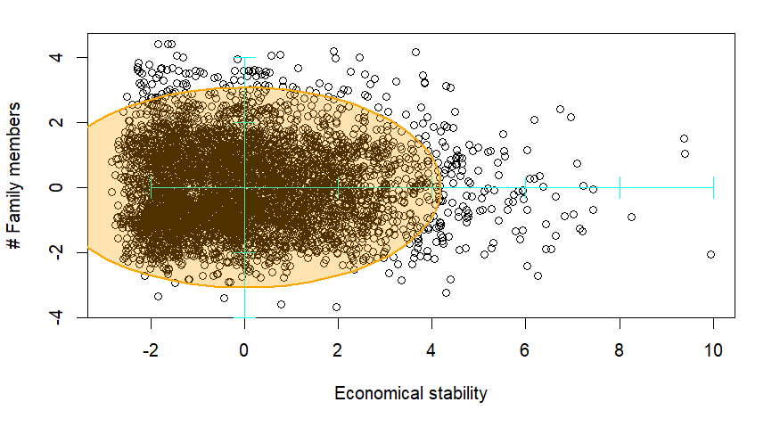
Outlier Detection
Mahalanobis Distance
Confidence interval = 95%
Notes:
Ji

Slide 30
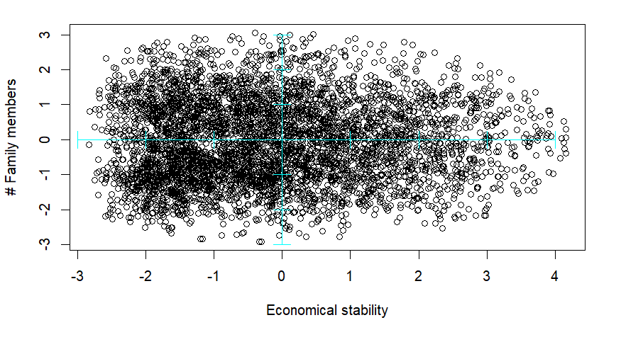
Outlier Detection
Mahalanobis Distance
Confidence interval = 95%
Notes:
Ji

Slide 31
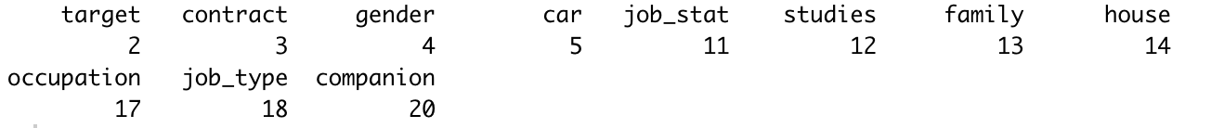
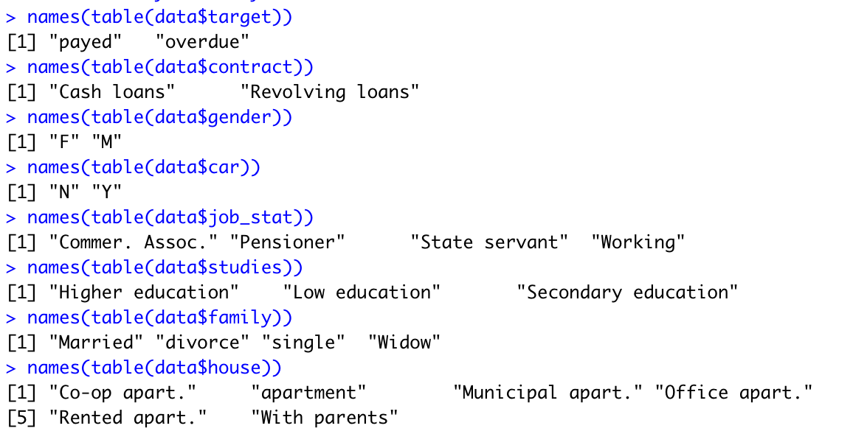
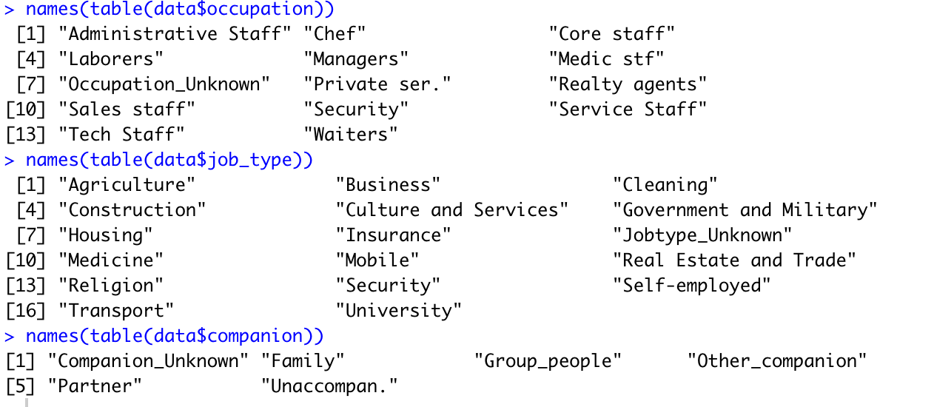
MCA - Multiple Correspondence Analysis

Slide 32
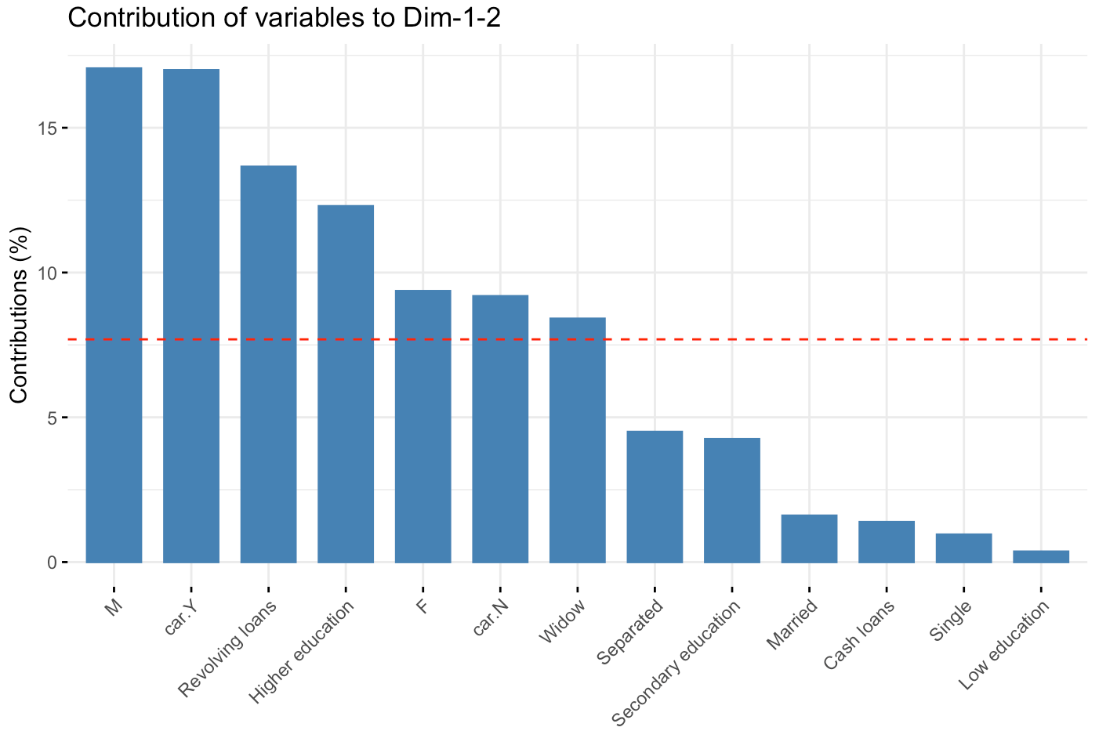
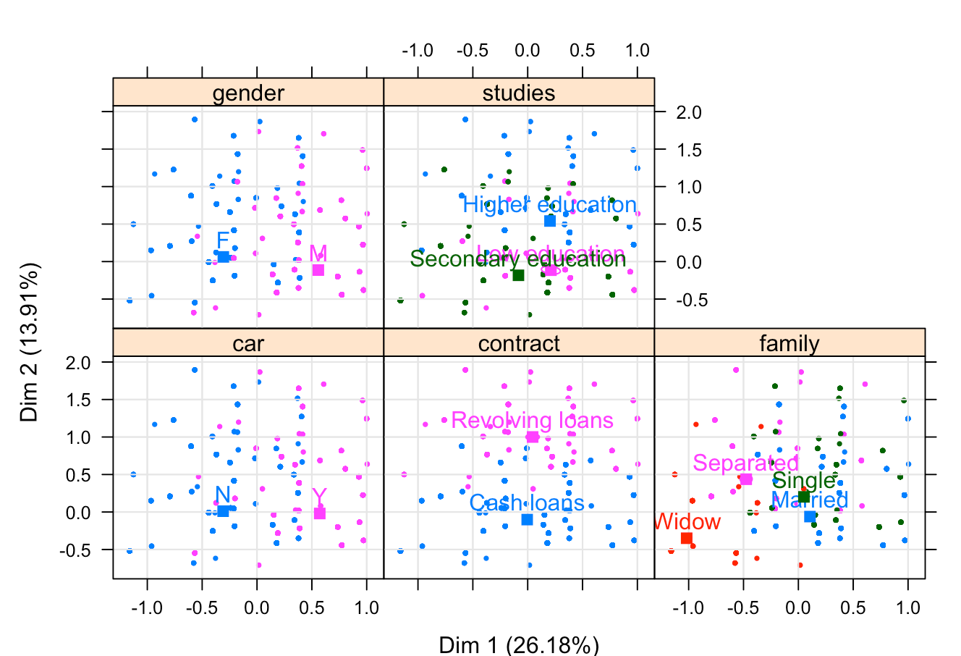
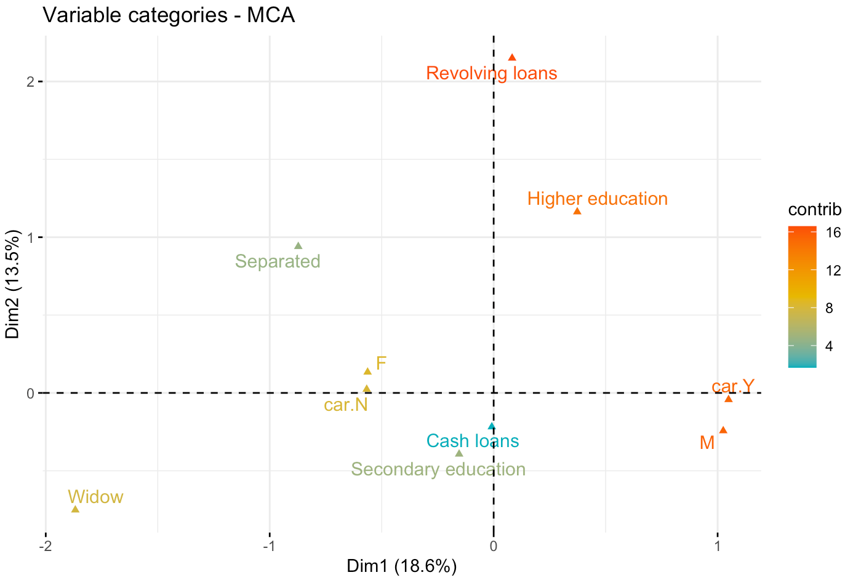

Slide 33
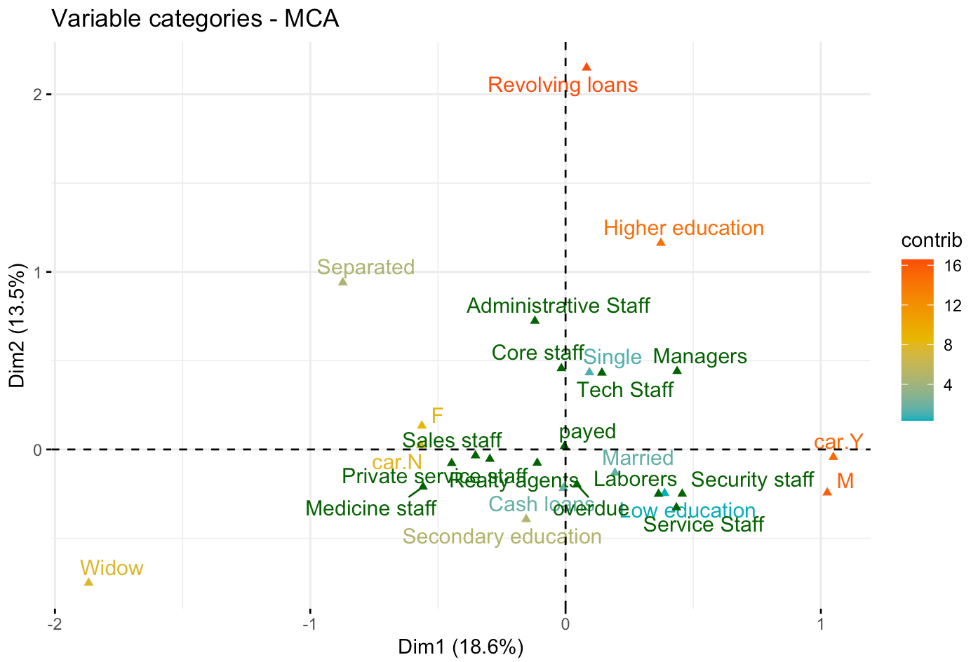
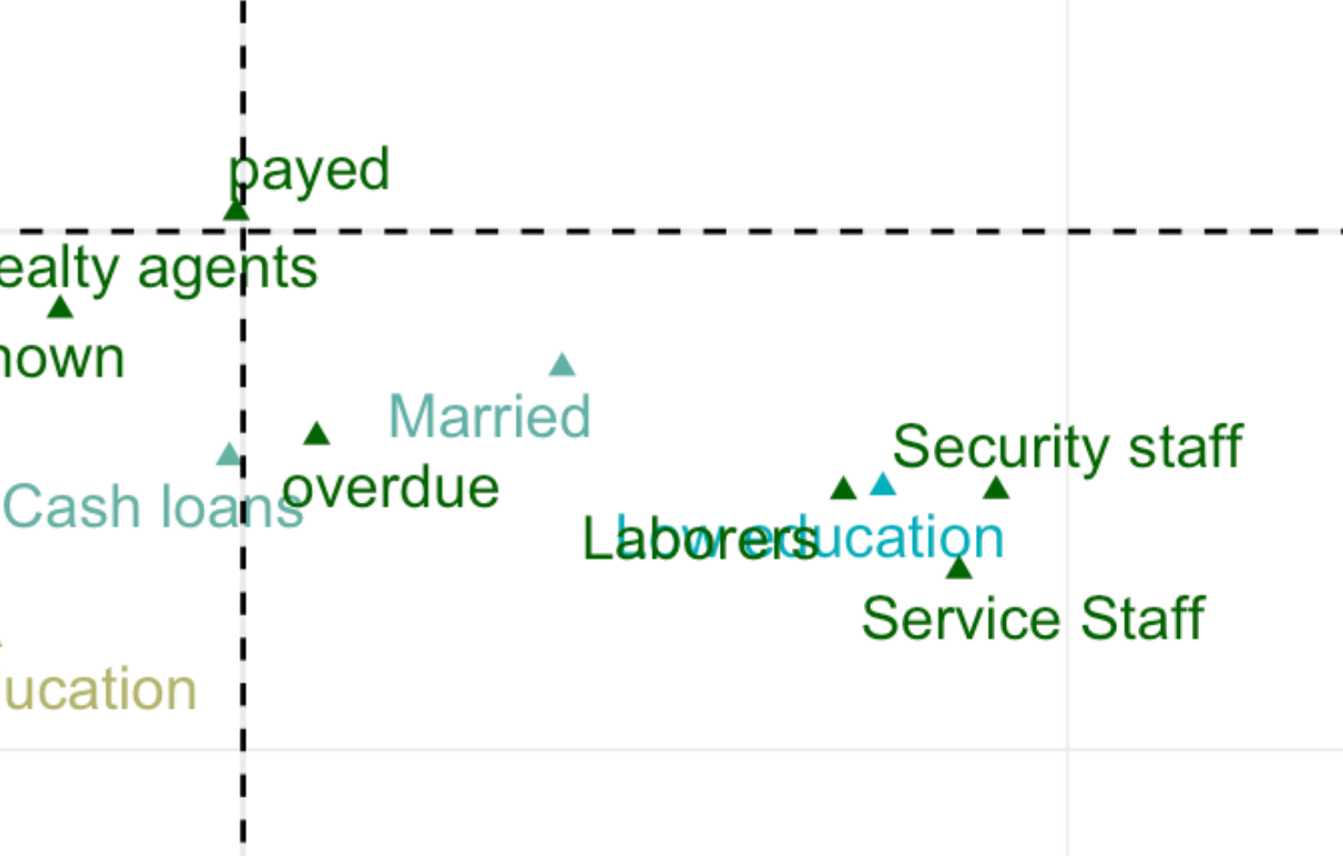
Add extra information in the plot

Slide 34
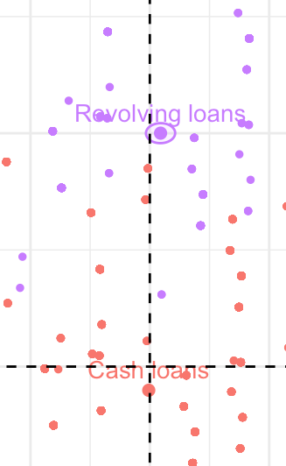
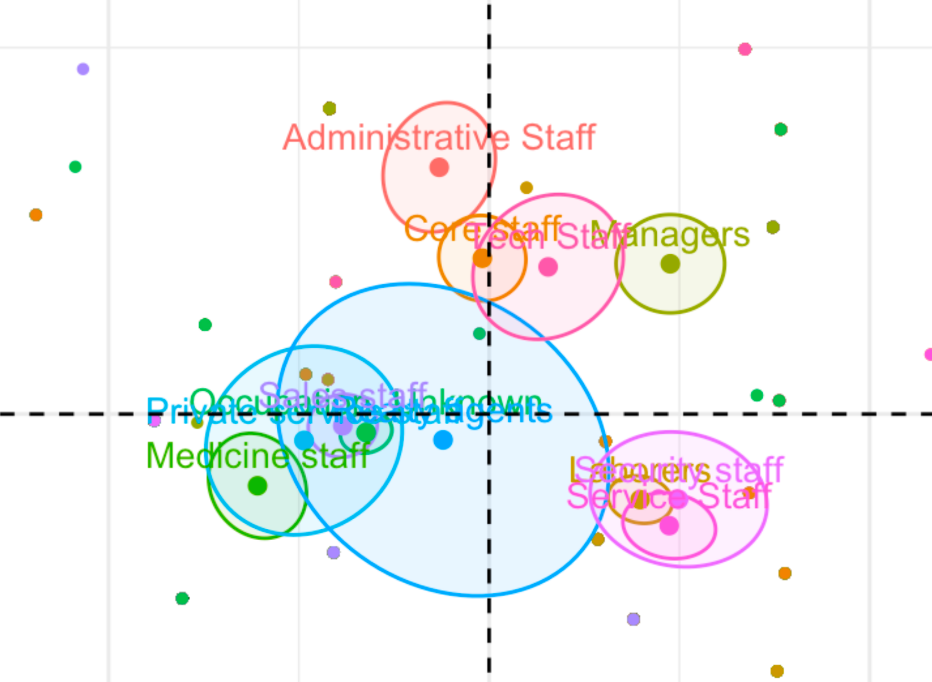
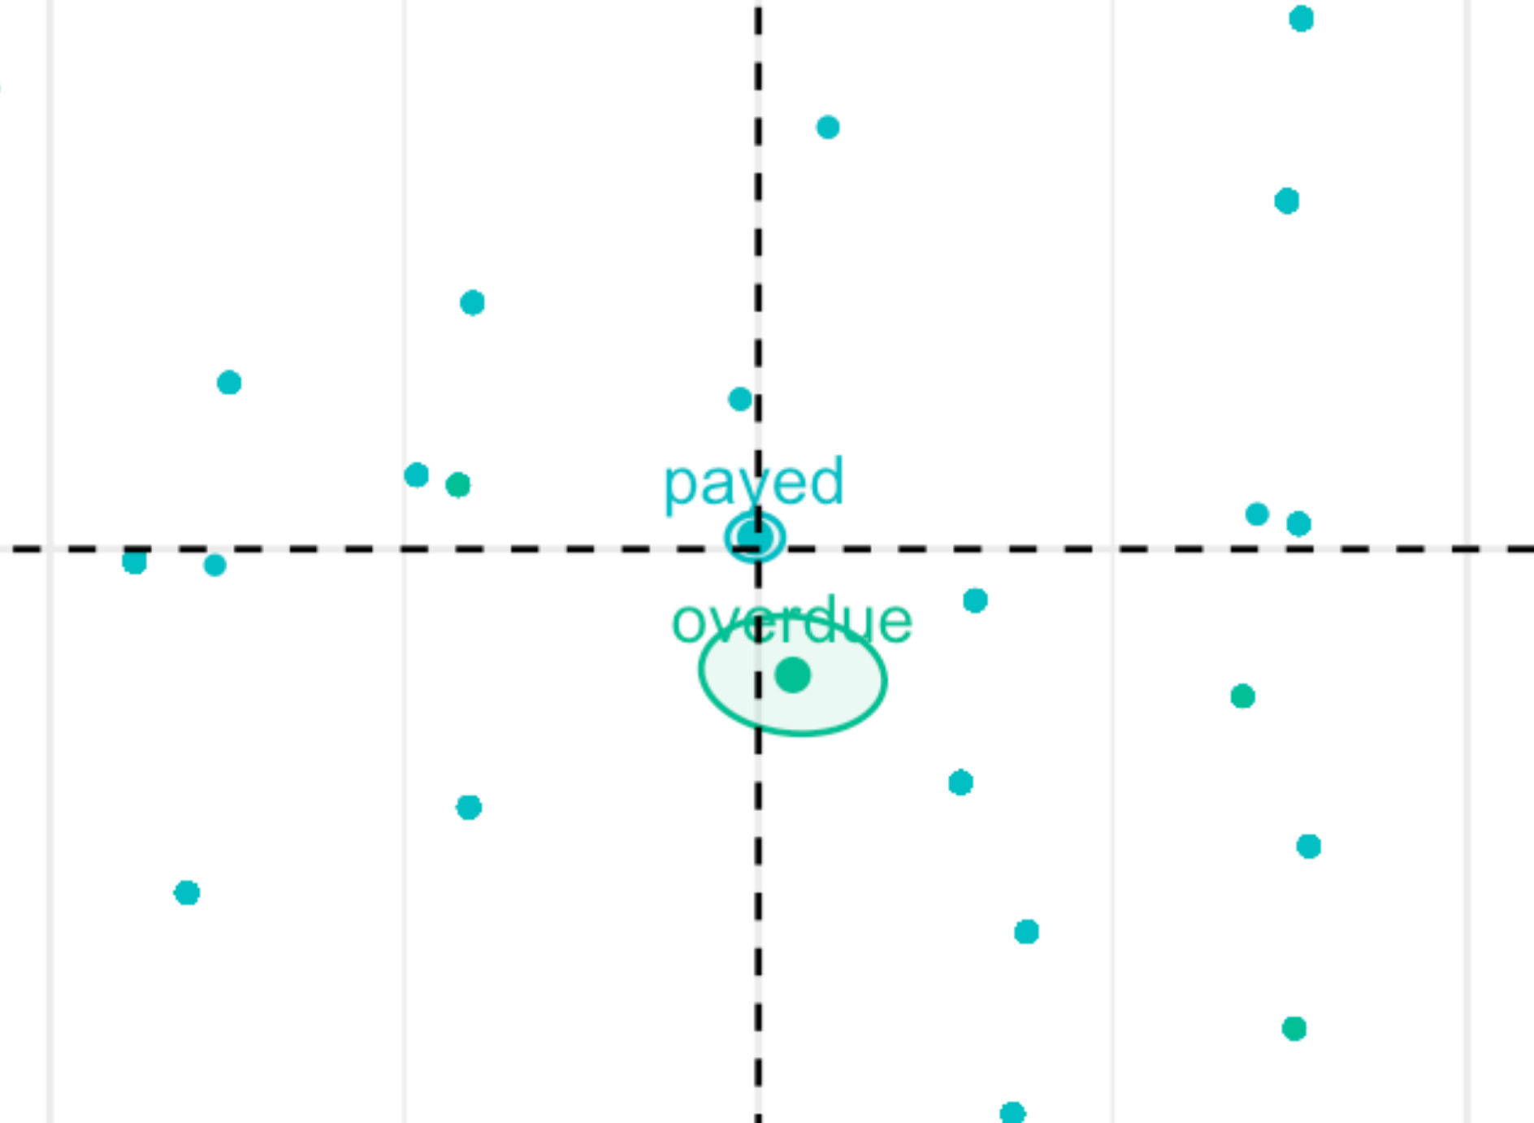
Revolving loan
Administrative, Managers, Core Staff, Tech staff
Service, Security, Laborers
Cash loan
payed
overdue

Slide 35
CONCLUSIONS
Univariate and bivariate analysis are not enough to extract knowledge in the sample, as patterns are too complex for those analysis
Based on our PCA analysis, we would suggest the bank manager to be careful when giving loans to single clients who are laborers with a low education and live in office apartments
With our MCA analysis we would recommend to the bank manager to watch out the people that are laborers, work on security or on services and ask for a cash loan because they are more likely to not pay the loan on time.

